Slide 1
Competitive Programming
20 September 2024

Slide 2
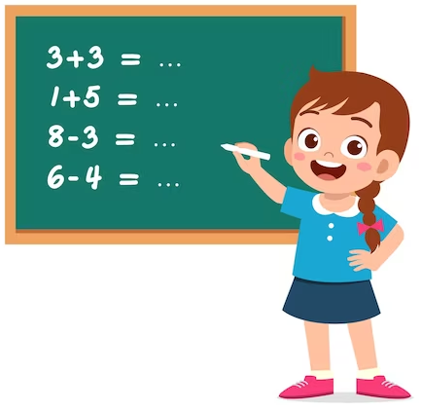
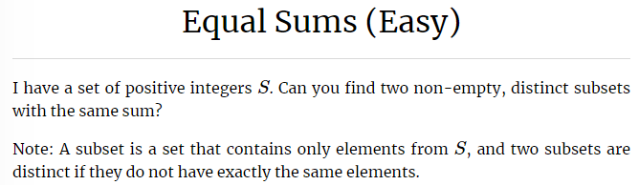
Practice I - Equal Sums (Easy)
Kattis: Equal Sums (Easy)
Link: https://open.kattis.com/problems/equalsumseasy

Slide 3
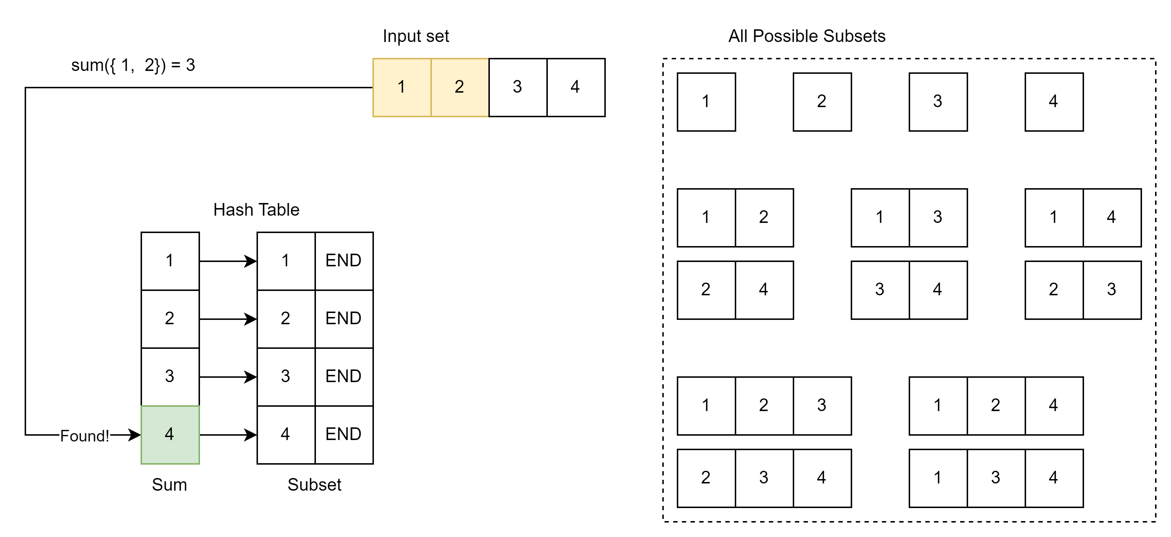
Practice I - Equal Sums (Easy) – Approach
Techniques:
Bit manipulation;
Traverse subsets;
Hash table;

Slide 4
Practice I - Equal Sums (Easy) – Solve it
Kattis: Equal Sums (Easy)
Link: https://open.kattis.com/problems/equalsumseasy
Solve the Task

Slide 5
Homework - Optional
Math related problem: Link to Kattis
Hints:
IF (X % Y == 0), THEN (X % (X % Y) == 0) too.
How the hint above helps to reduce complexity from O(N) to O(sqrt(N)).

Slide 6
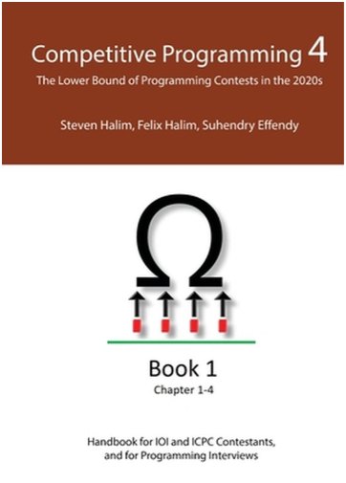
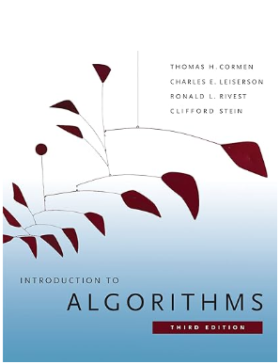
Where to Practice and What to Read?
Online resource for practice:
Kattis - https://open.kattis.com/
Leetcode - https://leetcode.com/
What to read:
Competitive Programming 4.
Theory + a lot of practice.
Introduction to Algorithms.
Very good theory.

